Slide 1
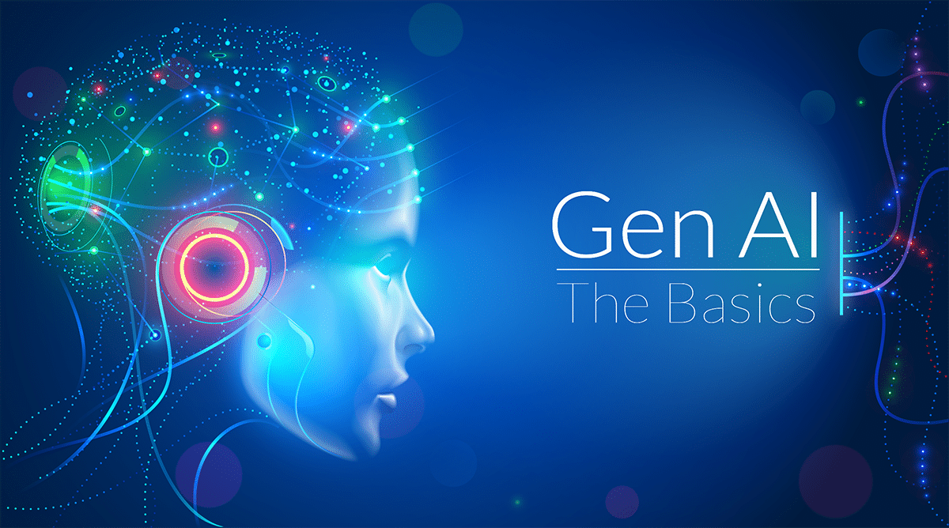


Generative AI: Transforming the Future
Exploring the Basics, Transformers, and Chatbot Innovations

Slide 2
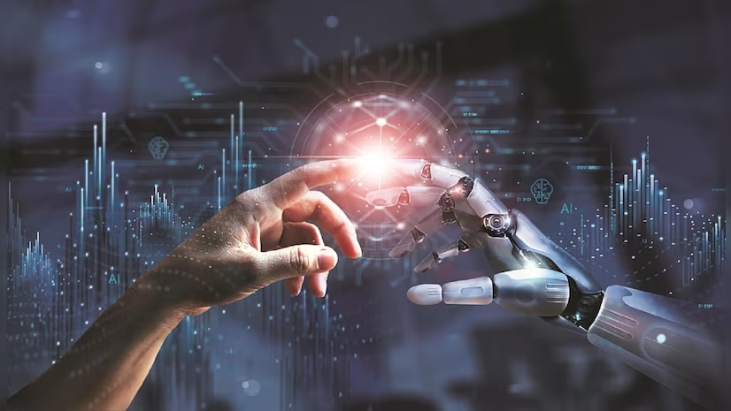
Agenda
Introduction
Working
Transformers
RAG vs Normal chatbots
Applications

Slide 3
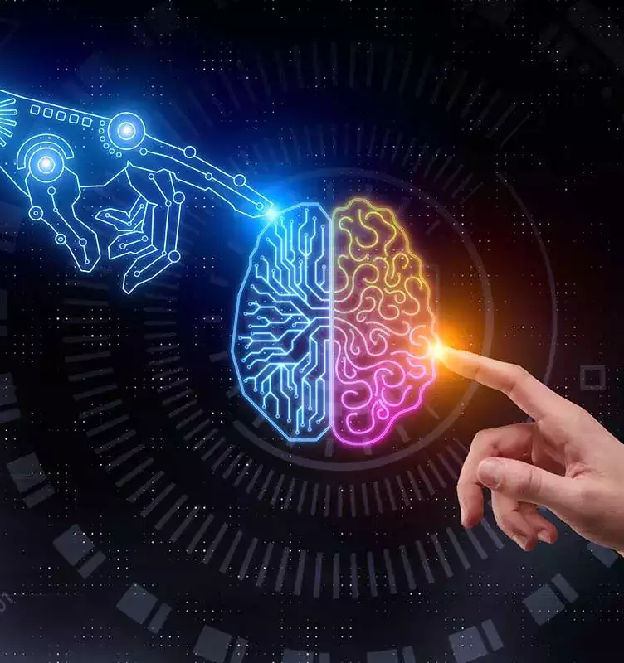
Introduction
What is Generative AI?
Generative AI refers to AI systems that can create
new content—text, images, music, videos, or even
code—by learning patterns from existing data.
Why it Matters?
Drives innovation across industries.
Reduces human workload in creative and analytical tasks.
Enhances personalization in technology.

Slide 4


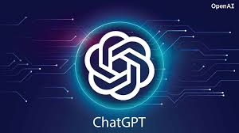
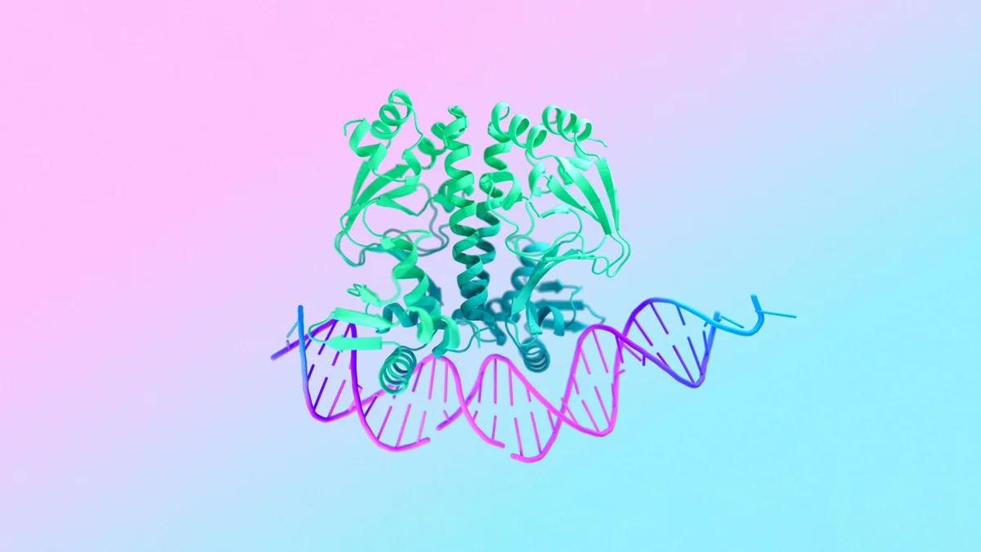
Real-World Examples
DALL·E
IBM Watson
ChatGPT
AlphaFold (DeepMind)
4

Slide 5
Benefits of Generative AI
Boosts creativity and innovation.
Reduces manual effort, improving efficiency.
Personalized content delivery in marketing and education.
Solves complex challenges in science and technology.

Slide 6
Challenges in Generative AI
Ethical Concerns: Deepfakes, misinformation, copyright issues.
Bias: Models inherit biases from training data.
Resource Intensive: Requires high computational power and large datasets.
Regulation: Lack of clear legal frameworks.

Slide 7
What are Transformers?
Deep learning models designed to handle sequential data efficiently.
They process input data all at once instead of step-by-step (like RNNs).
Key Components:
Encoder: Encodes the input sequence into a numerical representation.
Decoder: Generates output based on the encoded representation.
Attention Mechanism: Focuses on the most relevant parts of the input.
Applications:
GPT models for text generation.
BERT for understanding natural language.
Vision Transformers for image analysis.

Slide 8
Applications of Generative AI
Text Creation: Blog writing, code generation (e.g., GitHub Copilot).
Image Creation: AI art generation (e.g., DALL·E).
Healthcare: Drug discovery, medical image analysis.
Education: AI-generated tutorials and adaptive learning.
Customer Support: Advanced chatbots and assistants.

Slide 9
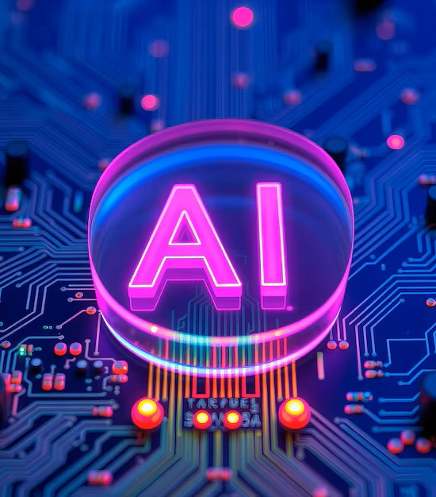
RAG vs Normal Chatbots
Normal Chatbots
RAG Chatbots
Combines retrieval of relevant external knowledge with generative capabilities.
Dynamically fetches and integrates information from a database or documents during conversation.
Example: AI assistants that provide real-time, context-aware answers.
Use pre-trained models with a fixed knowledge base.
Limited contextual understanding and static responses.
Example: FAQ chatbots or basic customer support bots.

Slide 10
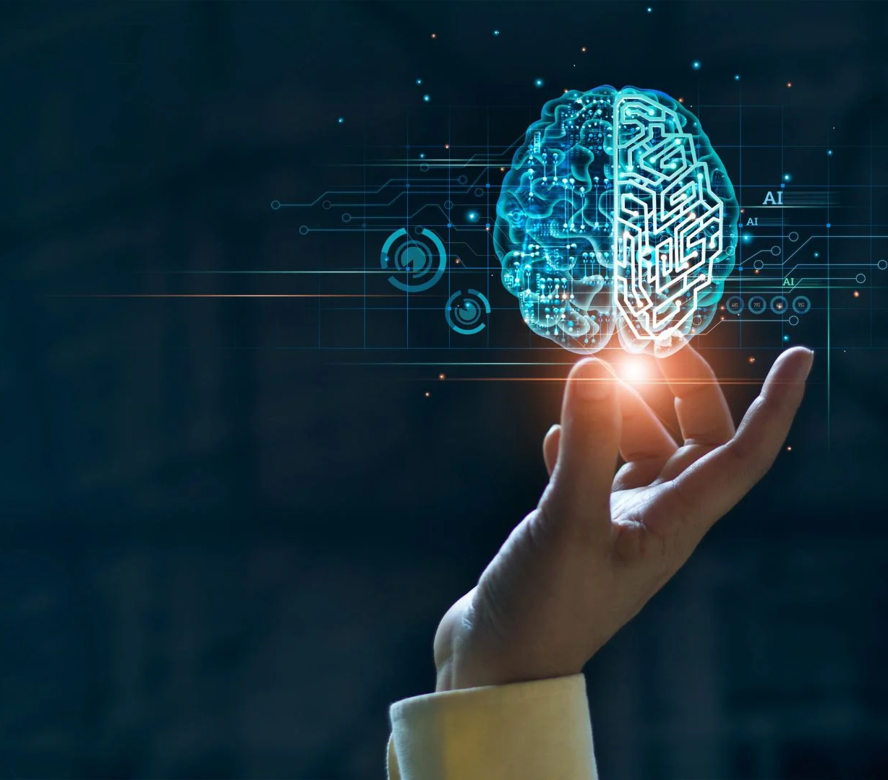
Thank you
BY
HARSHINI R (22CS031)
JANANI J (22CS034)
MOHANA PRASATH G (22CS050)
SHARMILA B (22CS088)

